Slide 1
Data Science Workshop
Guy Azov
Brian Gordon
Shachar Banayan
Tomer Moinian

Slide 2
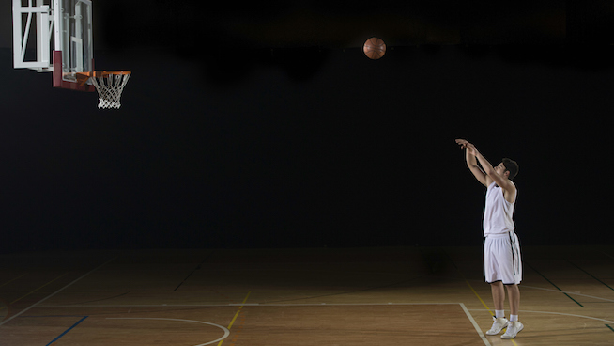
Project Goals
NBA Free Throws Prediction
Main Target: Try to predict whether a player will score a certain free throw (online prediction).
Secondary Target: Predict the players success percentage for the current season based on his past performance and give the coach an insight about the player (offline prediction).

Slide 3
Our Data
We chose a Kaggle free throws database and added a web scrapper for more players stats.
Our database includes:
617,786 NBA free-throws with 19 variables:
end_result
game
game_id
period
play
player
Position
FG%
3P%
FT%
Height
Weight
ShootingHand
draftRank
playoffs
score
season
shot_made
time

Slide 4
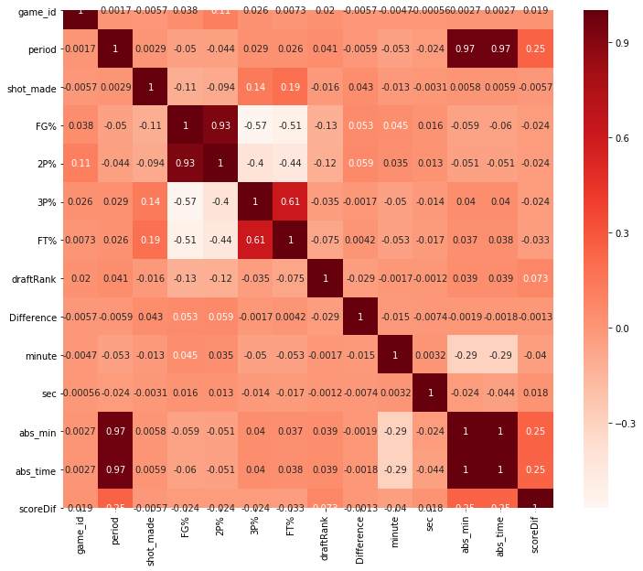
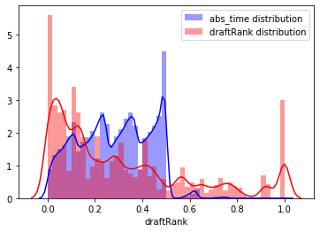
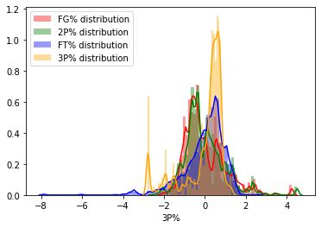
Data Understanding
We analyzed the dataset and checked the correlation
between our variables.
We chose the relevant columns for our prediction problem
We modified our data and manipulated it so it fit into machine learning model
manipulating the data using minmax scalar and standard scalar
Finding correlations

Slide 5
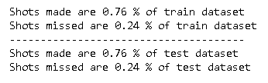
train-test split
Our data is unbalanced, 76% of the throws with shot made and 24% with shot missed
We split our data to train and test randomly and made sure we keep this ratio in the train and test groups:

Slide 6
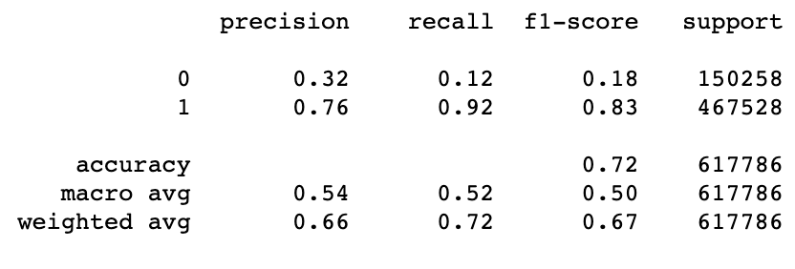
Baseline Model
Model without learning
Prediction based only on FT%
Threshold classification, FT% > 0.5 predicted as shot made, else missed.
Performance:

Slide 7
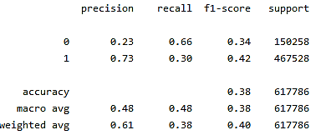
Another Baseline Model
As suggested by prof. Deuch, we tried a random model which toss a coin with the player’s ‘FT%’ score as it’s probability

Slide 8
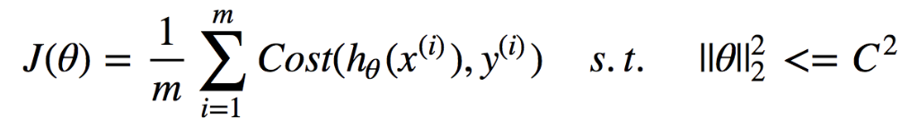
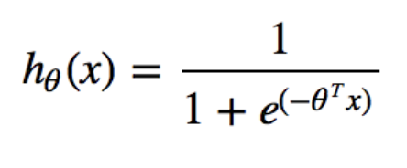
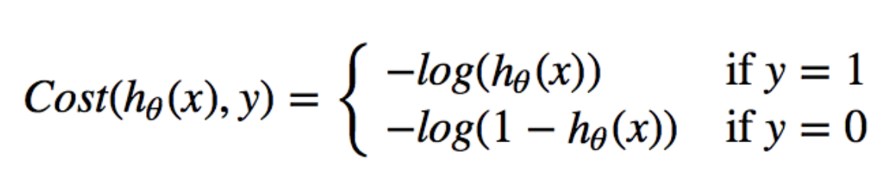
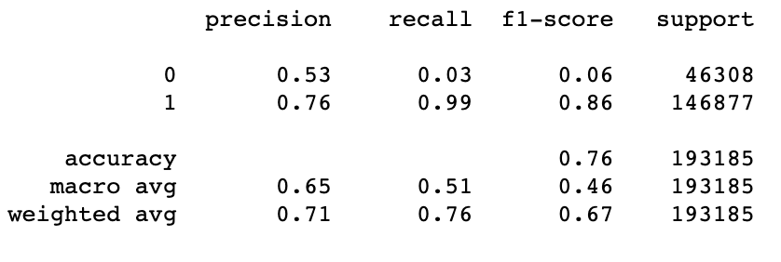
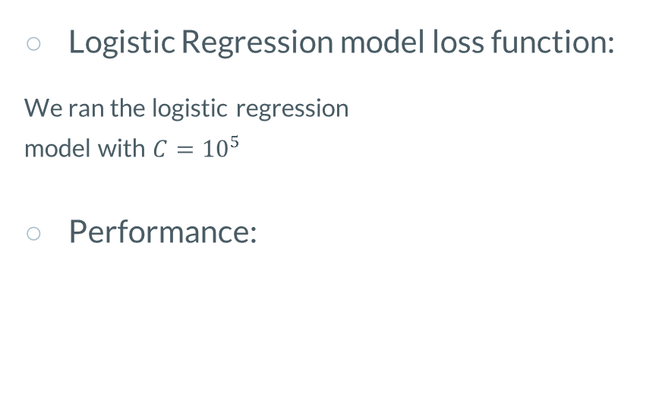
Log-Regression Model
Logistic Regression model loss function:
We ran the logistic regression
model with $C={10}^{5}$
Performance:

Slide 9
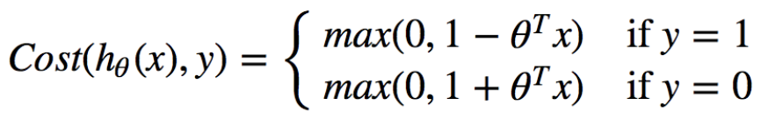
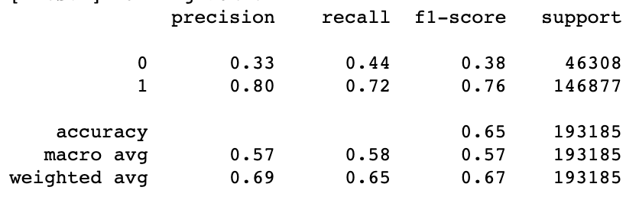
Linear SVM Model
Linear SVM model loss function:
We ran the SVM model with
kernel = ‘linear’
class weight = ‘balanced’
verbose = True
C = 1
Performance:
Notes:
השתמשתי במה שהיה לנו קודם, זה עם החלוקה הקודמת לאימון ומבחן

Slide 10
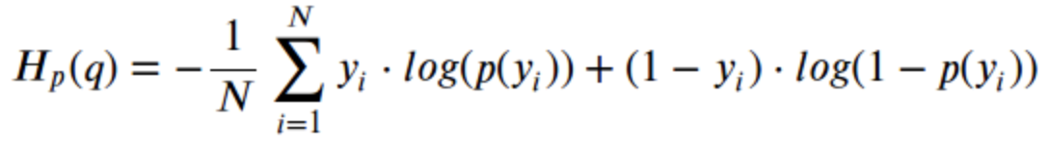
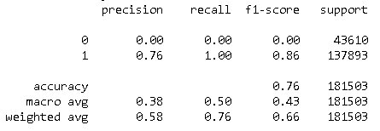
Neural Net – Binary Cross Entropy LOSS
Neural Net - Binary Cross Entropy LOSS:
Notes:
להוסיף את הפרמטרים שהשתמשנו בהם ברשת, מבנה הרשת

Slide 11
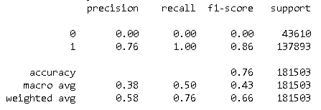
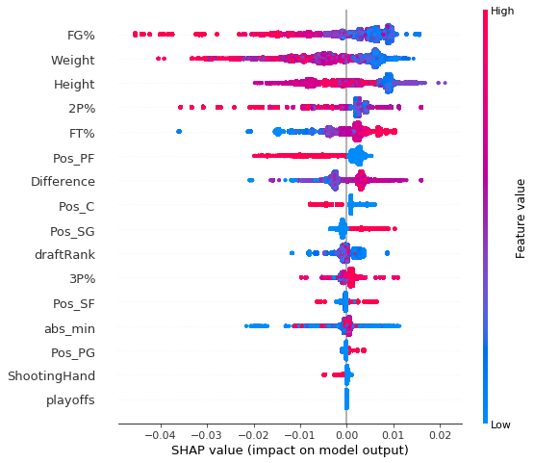
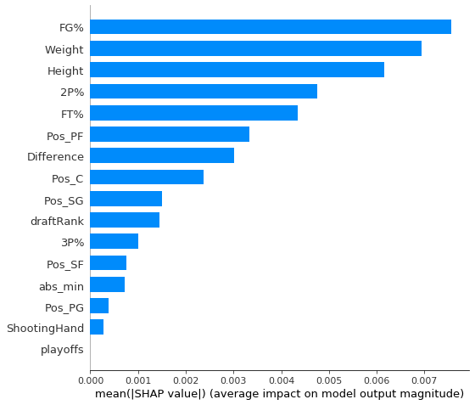
Xgboost Regressor Model
We can see here, which parameters influence more on our model in order to predict a class category.
Shap visualization

Slide 12
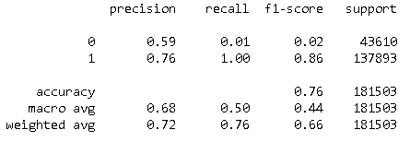
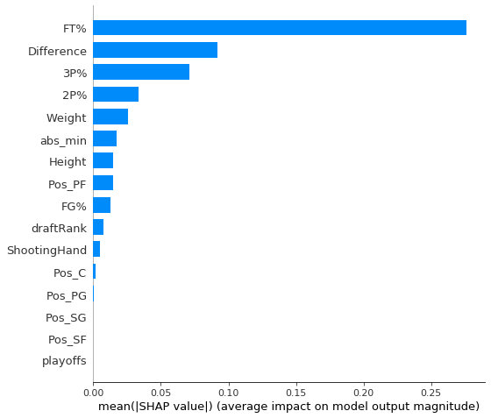
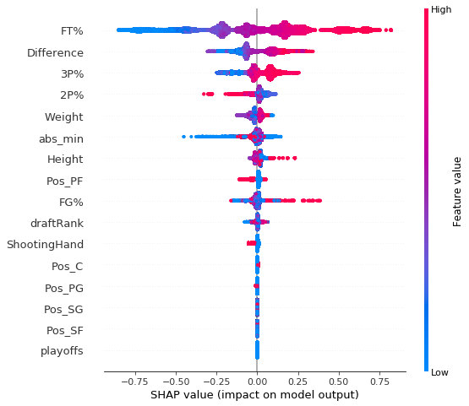
Xgboost Classifier Model
Shap visualization
Notes:
יש פה בעיה עם התוצאות שלנו!

Slide 13
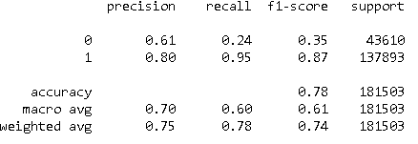
Random Forest Model
Random Forest Model:
We ran a random forest model with these parameters:
# Estimators = 16
Max. tree depth = 20
A slightly improve!!

Slide 14
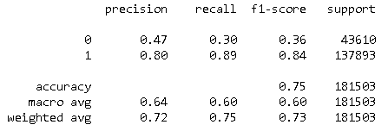
K-Nearset Neighbours Model
K-Nearset Neighbours Model:
With the parameters:
K = 5
Metric Distance – Eucledian
Now our recall get’s better but our accuracy it’s smaller.
NO FREE LUNCH

Slide 15
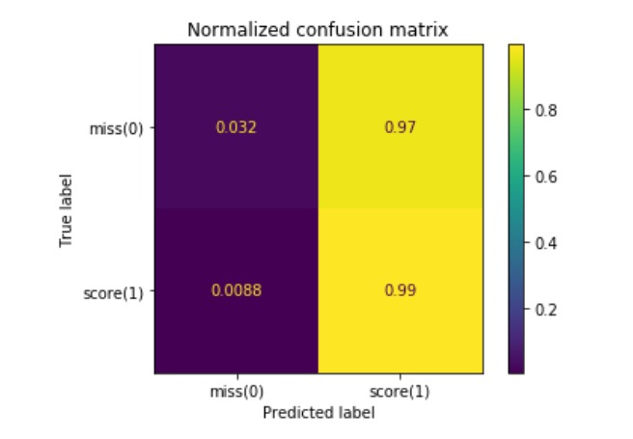
The unbalanced database problem
We can see that because our dataset is un-balanced, our models tend to predict '1' (shot made) most of the time, as we can see for instance by the confusion matrix of the logistic regression model –
This tendency to predict mostly ‘1’ cause the recall of the lower represented class (‘0’) to be extremely low.
Our goal is to make this recall higher while not decreasing the accuracy metric.
Notes:
להוסיף את הפרמטרים שהשתמשנו בהם ברשת, מבנה הרשת

Slide 16
Trying to balance
the database.
OVERSAMPLING
We oversample the smaller class, so there is an equal amount of misses and scores in both train and test. This can be achieved by simply duplicating examples from the minority class in the training dataset prior to fitting a model.
SMOTE
Synthetic Minority Oversampling Technique
SMOTE works by selecting examples that are close in the feature space, drawing a line between the examples in the feature space and drawing a new sample at a point along that line.

Slide 17
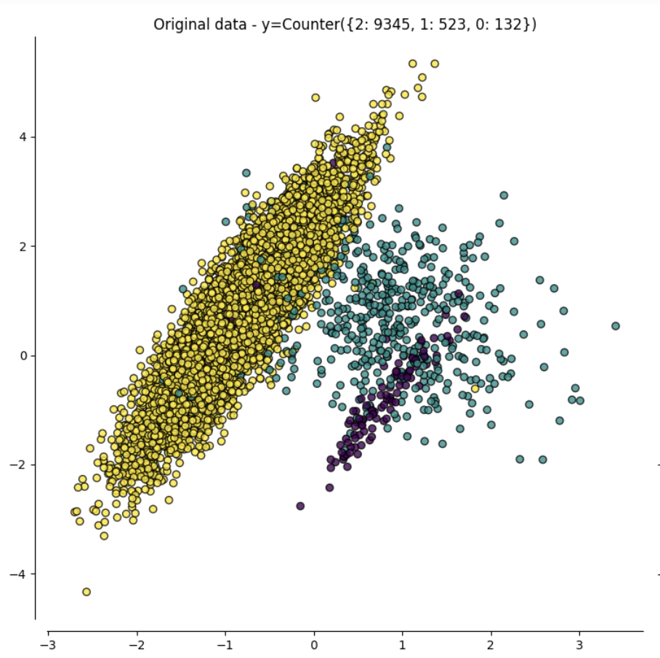
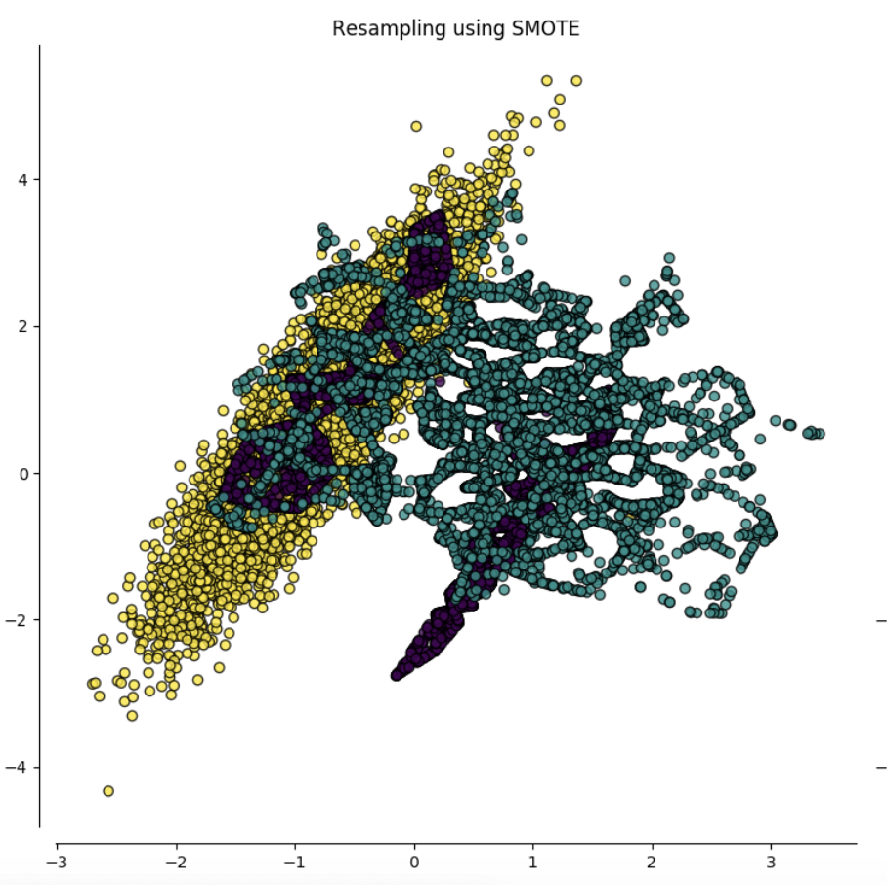
SMOTE

Slide 18
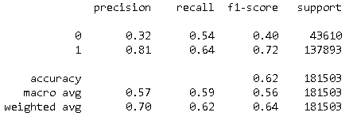
SMOTE Performance
We checked this oversampling method with a NN network.
We can see that this method helps us to achieve better recall metric on the ‘0’ class , but we receive a -10% performance on accuracy.

Slide 19
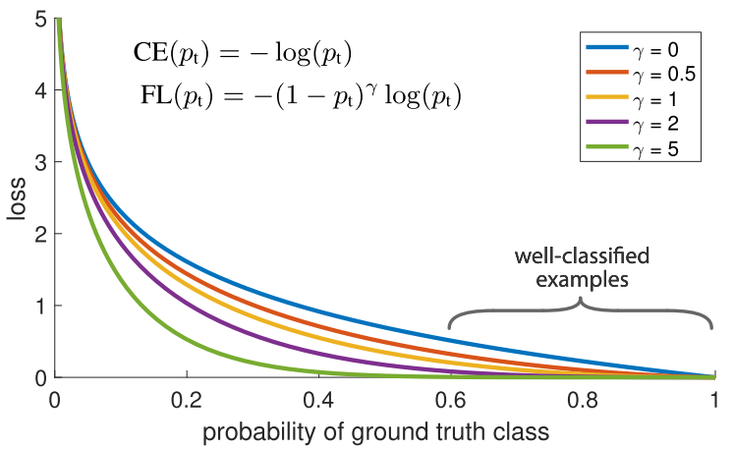
FOCAL LOSS

Slide 20
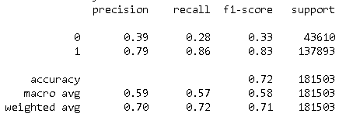
Trying to use FocalLOSS (NN)
Another way to confront the unbalanced dataset is the Focal loss. It down-weights the well-classified examples, so used it to ensure that we also achieve high accuracy on our minority class by giving them more relative weight during training.
we get an improvement on our label '0' recall , but our accuracy performance is still lower than the baseline model

Slide 21
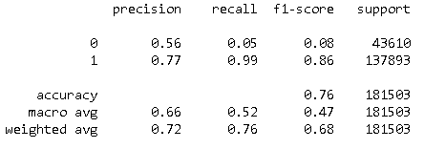
Xgboost classifier model with FocalLoss
XGboost classifier model with FocalLoss:
We also tried running the XgboostClassifier model
with focal loss but the recall has almost not improved.
Notes:
יש פה בעיה עם התוצאות שלנו!

Slide 22
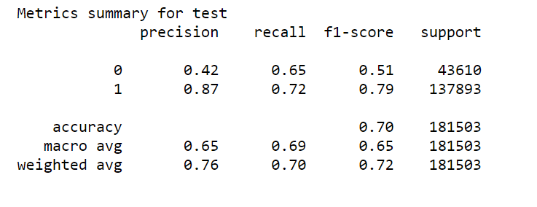
Increasing the decision threshold
Another strategy is to make the model choose ‘1’ only if it has “confidence” with this choice (determined by a pre-defined threshold).
Instead of classifying a datapoint to ‘1’ category if p(Xi) > 0.5, we decide to search for a more confident threshold for this.
For example, after grid-searching the best achieved recall by the threshold parameter, we got with a Random Forest model .
As we can see the recall here is a lot higher while we didn’t heart the accuracy badly.

Slide 23
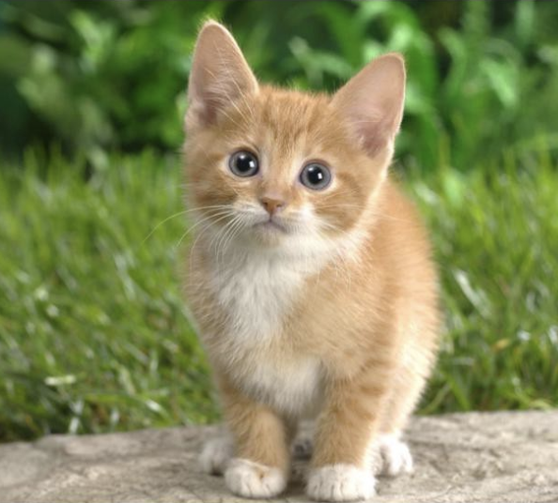
Which animal is on the picture?

Slide 24
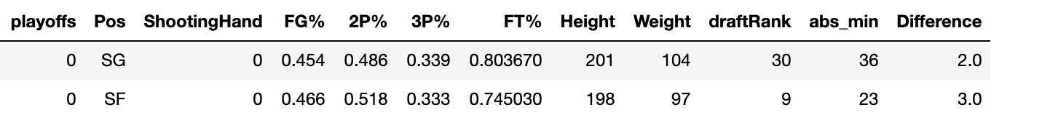
Miss or Hit ?

Slide 25
Dataset partial conclutions
As we explore our models and try to understand their behavior, we noticed that we have very similar datapoints belongs to opposite classes.
Try using free throw probability as a target instead of binary result. (Regression instead of classification).
Predict a probability of success per free throw and compare it to ”real probability” of success.

Slide 26
What’s next?
Try focal loss, oversampling and threshold changing with all our models.
Hyper-parameter tuning.
Ensemble of models.
Try to confront non-separability of the data.

